Slide 1

Semester 2 Final Project:
Aryan Kumar, Chidvi Doddi, Frankie Luu, Western Han, Shravani Manda

Slide 2
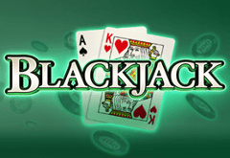
About the game
BlackJack
Your goal is to get 21 points or as close as possible without going over 21
If your total point is below you can “hit” to get another card or stay with the amount you already have
If your total point is over 21, you lose
If your total point is still below 21, you can hit to get another card
All face cards = 10 pts
Ace = 1 pt

Slide 3
User Manual
The game will start you with $10,000 and you need to make a bet on the next round against the computer. Each round starts with you getting two cards and the computer getting two cards. The goal is to get the sum of your cards closest to 21 without going over. You can ask for another card if your total is under 21 by typing H(hit/add another card to hand) or S( to stay). If the sum of your cards is closer to 21 (than the sum of the computer’s cards), your bet is added to your total. If you don’t get closer or go over 21, then the bet is subtracted.

Slide 4
Rules
You start with two cards press H or S if you want another card added to your hand.
You can then make a bet as long as it is less than your total amount of money
Make sure to add the cards in your hand because you don’t want to go over 21.
If you chose S you have the option of doubling your bet
If your hand total is more than the CPU’s while staying under 21 then your get the money that you bet added to your total

Slide 5
Concepts of Programing (Screenshots provided):
Lists
Iterator
Inheritance
Recursion
Abstraction
Loops
Conditionals

Slide 6
Lists
This list is used when creating the deck. We combine this with the iterator in the next slide to fill the deck up with cards of each suit and number.

Slide 7
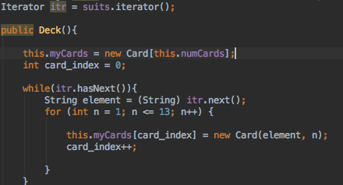
Iterator
We used iterators so we can easily iterate through all the elements of a List, which we have mentioned in the previous slide.

Slide 8
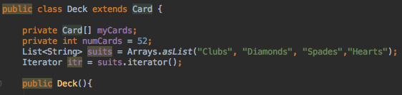
Inheritance
We used inheritance to make it easier for the subclass, Deck, to access the instances and methods from the superclass, Card. Basically, now code reuse can be easier.

Slide 9
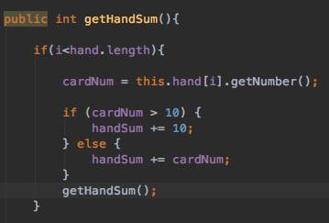
Recursion
Initially we used this code to add up the total cards in the user’s hand but after multiple trials we realized that using a for loop had a faster runtime so we changed our code to not include recursion.

Slide 10

Abstraction
This class uses the other classes and the methods to execute the gameplay of blackjack. It takes the big task of playing blackjack and breaks it down into the smaller tasks of player declaration, deck creation and card creation.

Slide 11
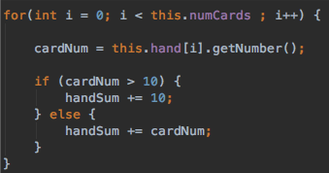

Loops
We used the for loops to repeat segments of code over and over instead of calling the same segment of code multiple times. A while loop is used to repeat a part of code until we have an initial condition met.

Slide 12

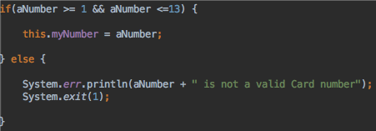

Conditionals
This segment uses conditionals to provide alternate ways when an action is made. It is used to keep the flow of the game, BlackJack.
H

Slide 13
Post Project Reflection
Looking back at the project, it was fun to combine what we have learned throughout the year and make a simple BlackJack game. Even though communication might have been an issue, everyone still had the desire to help and pitch in ideas, which instead of providing obstacles, provided assistance. We encountered many bugs and it was clear to see how the “small things can really make big differences.” Also, the game is user-friendly because the game tells player what to do in case they ever forget and provides a smooth transition between each new game.

Slide 14

THANKS FOR LISTENING

